Slide 1
THG Simulations
Project update: follow-up
Week 3B
11/08/2023
David Amorim

Slide 2
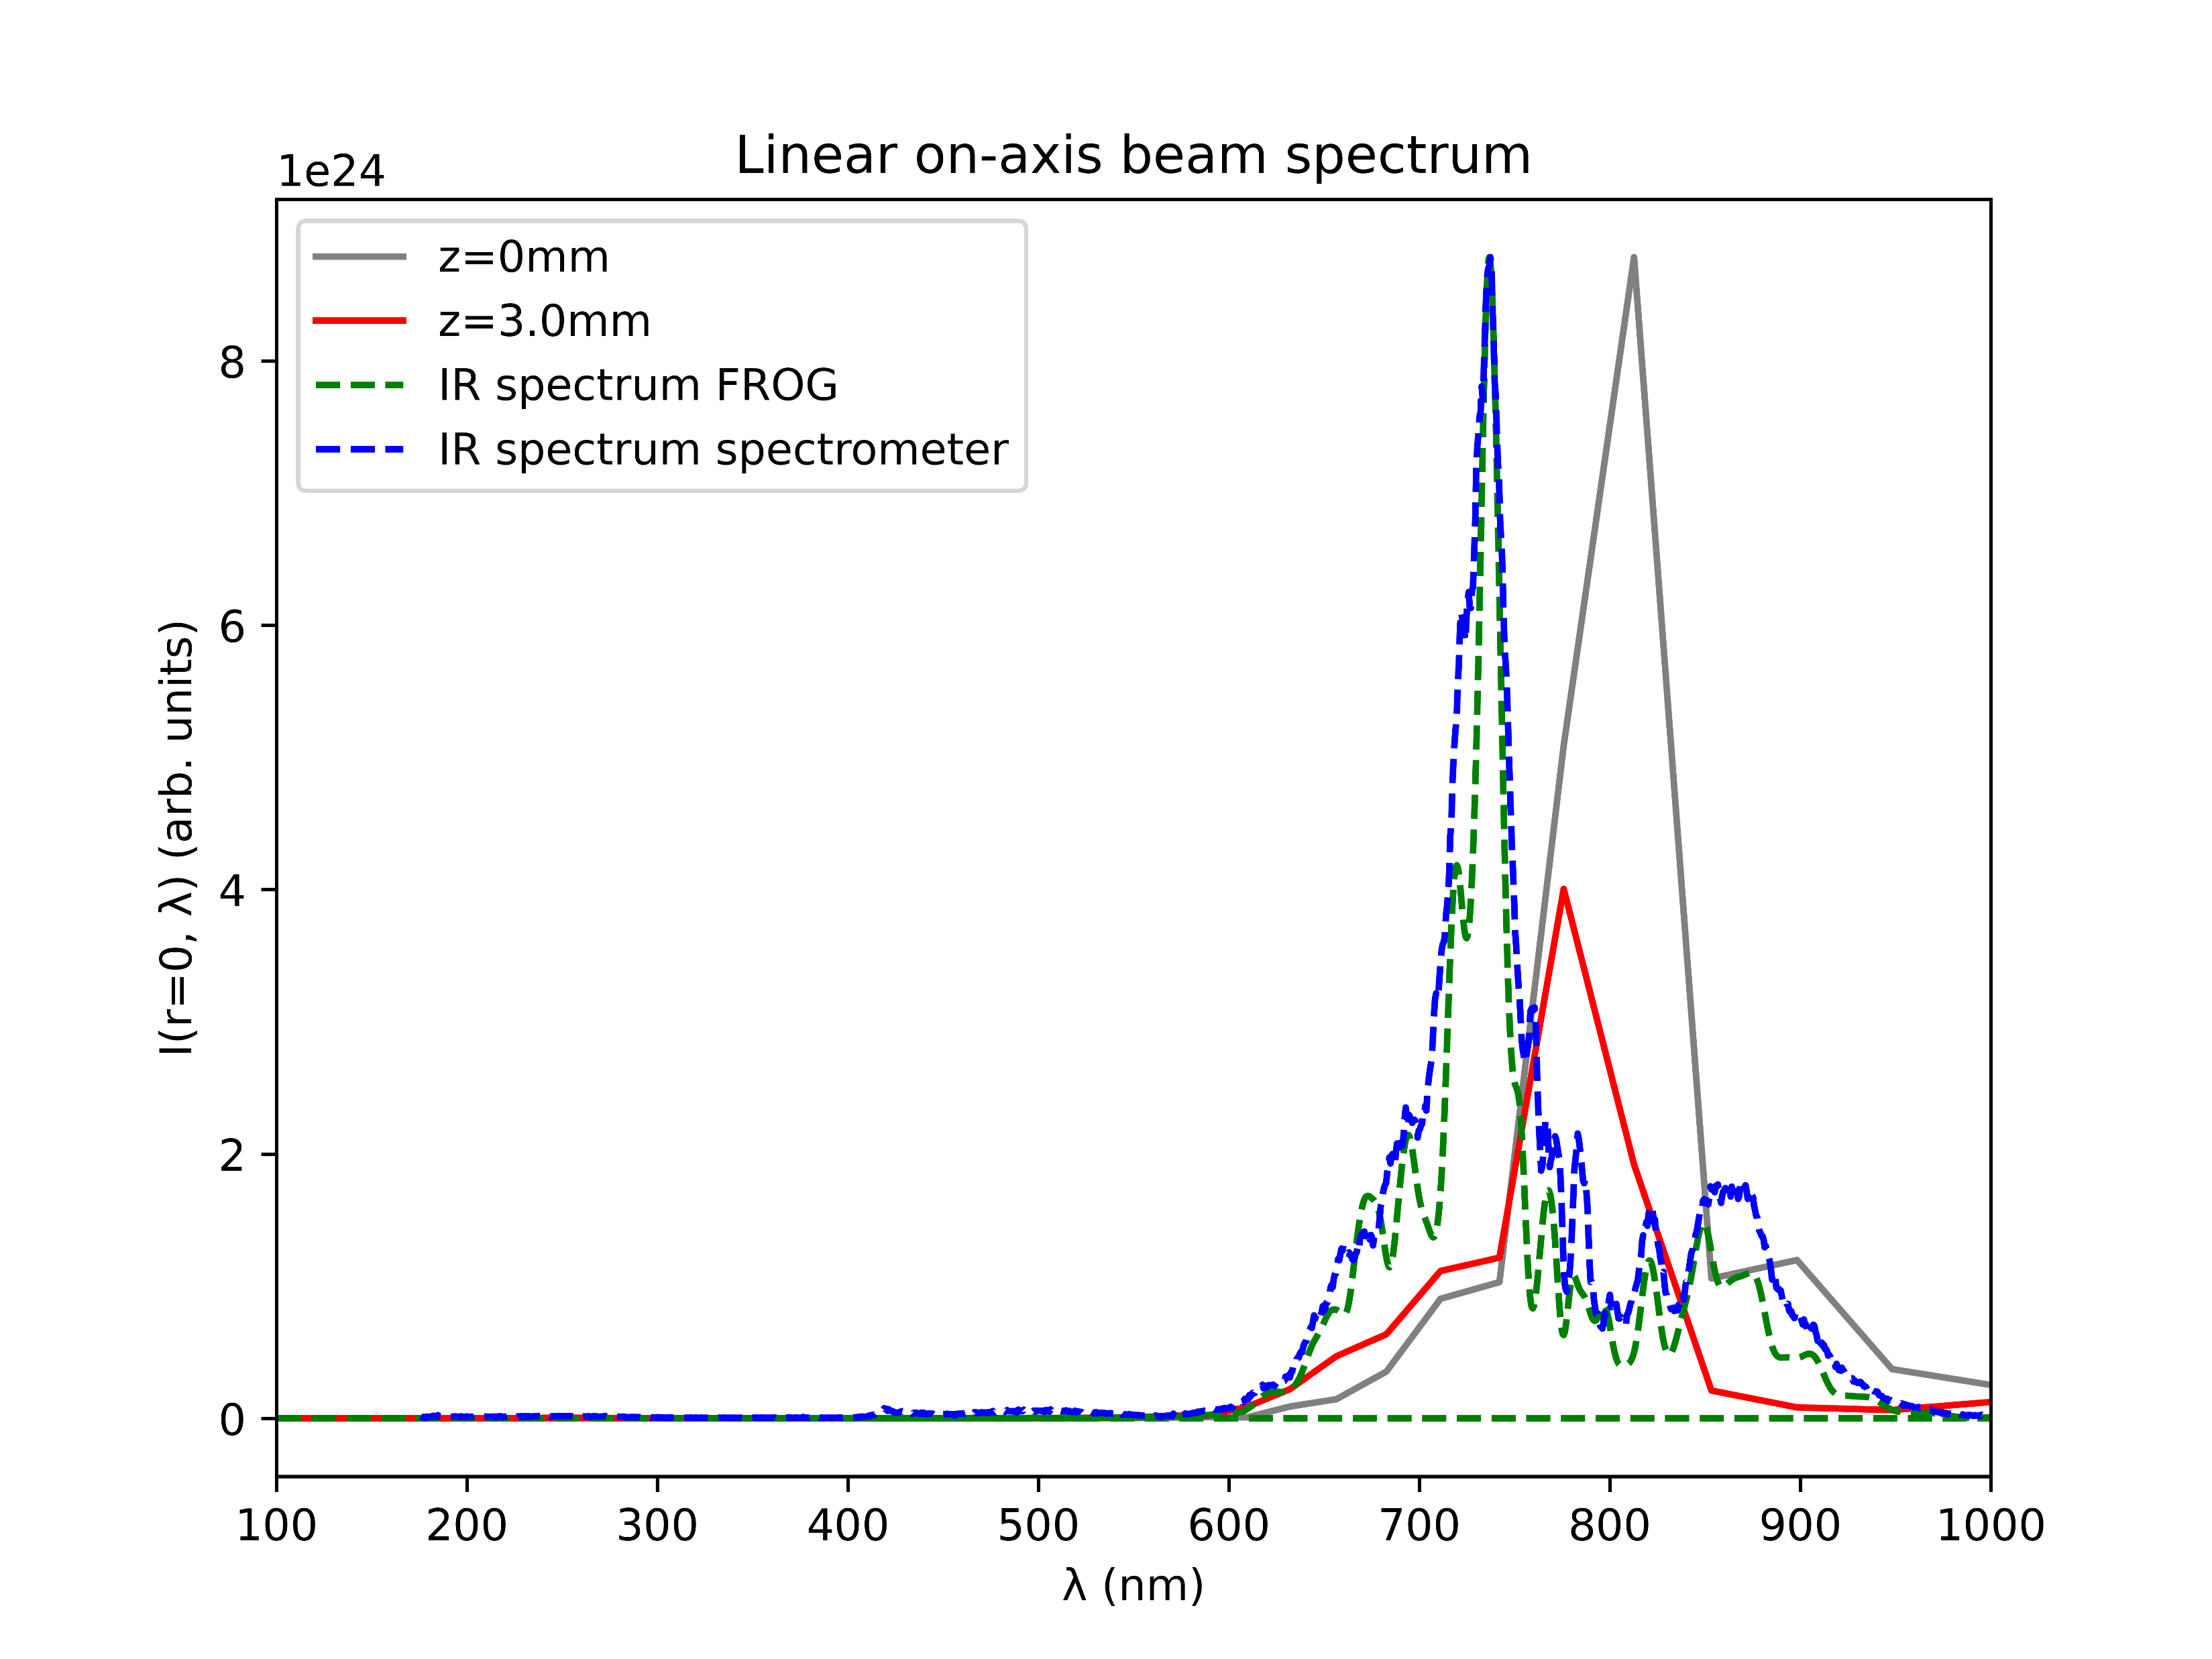
Comparison of spectra
IR spectrum calculated from FROG largely agrees with IR spectrum measured by spectrometer
The shape of the spectra also agree with the simulated IR spectrum (grey)
However, the measured spectra are centred around 730nm, not 800nm
Set the central wavelength to 730nm in the simulations?

Slide 3
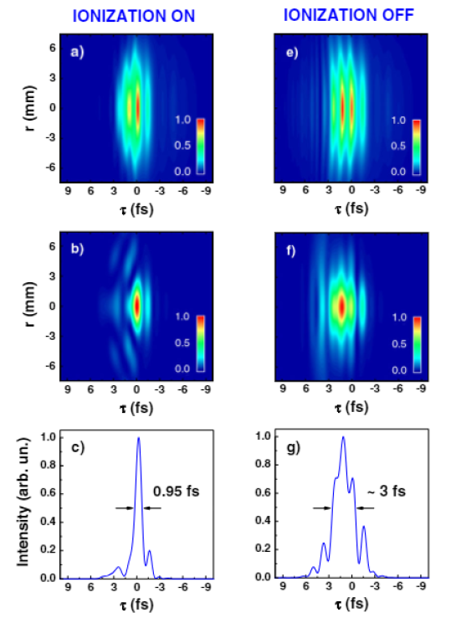
Reproducing plots from Reiter et al. 2010
In Reiter: spatiotemporal evolution of UV and IR beams; comparison with and without ionisation
In the following: simulated a similar comparison (150mW Argon at 1.0 bar)
Note: the parameters of Reiter could not directly be reproduced due to simulation breakdown
attempts with similar parameters were only moderately successful
IR
UV
UV
Reiter 2010

Slide 4
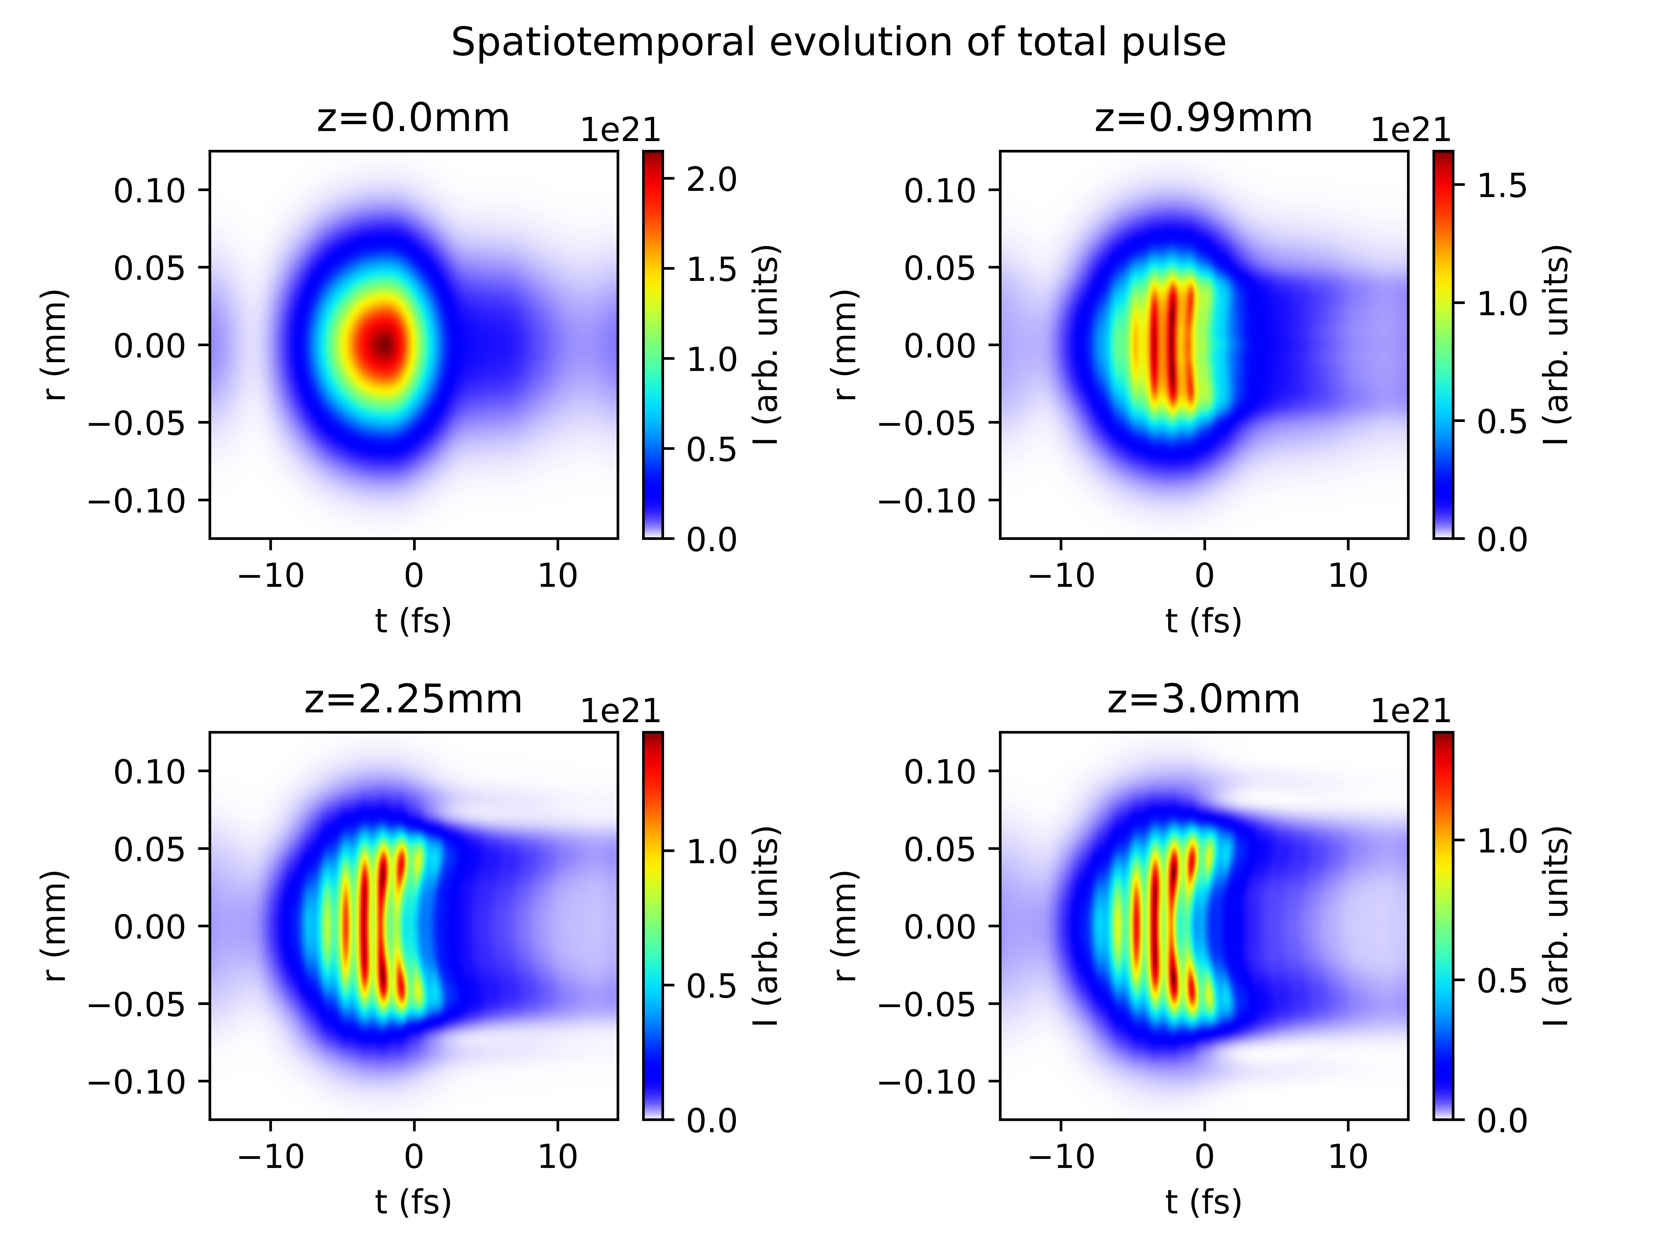
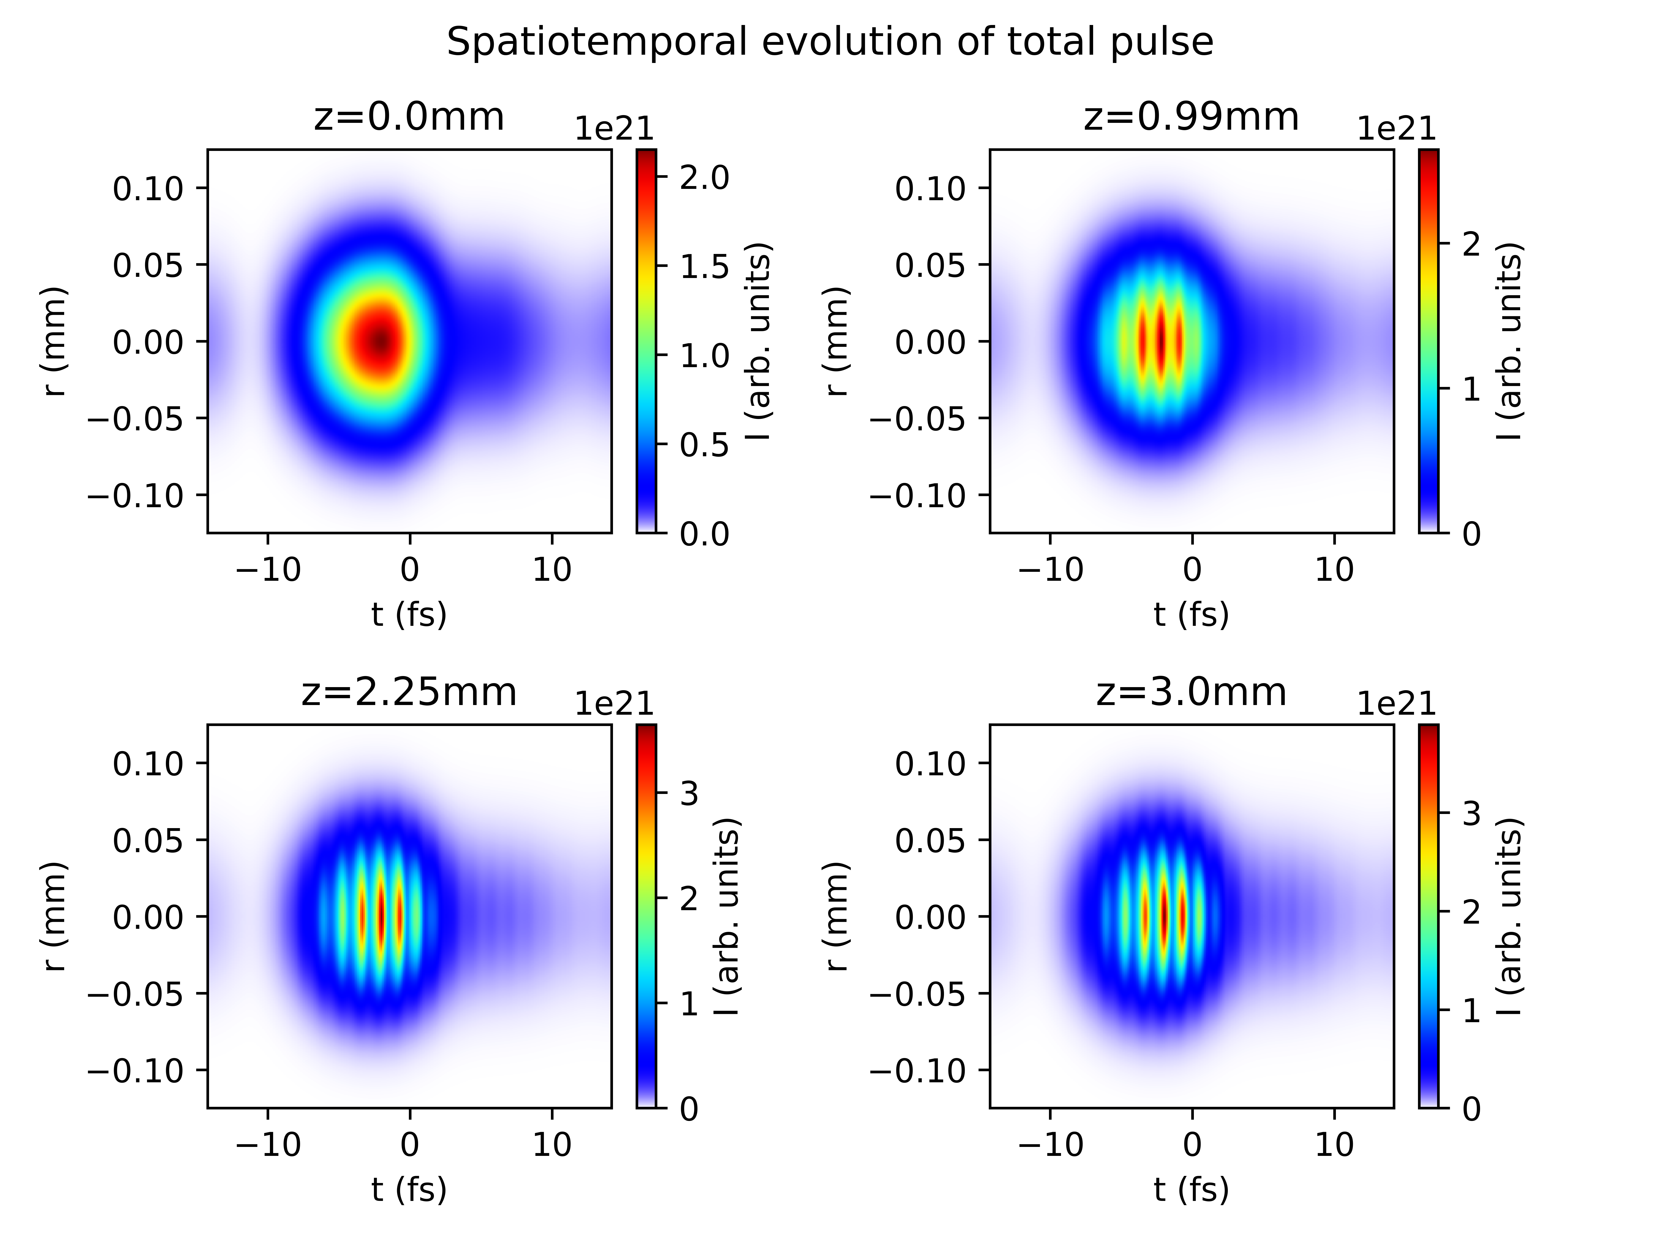
Reproducing plots from Reiter et al. 2010
With ionisation
Without ionisation

Slide 5
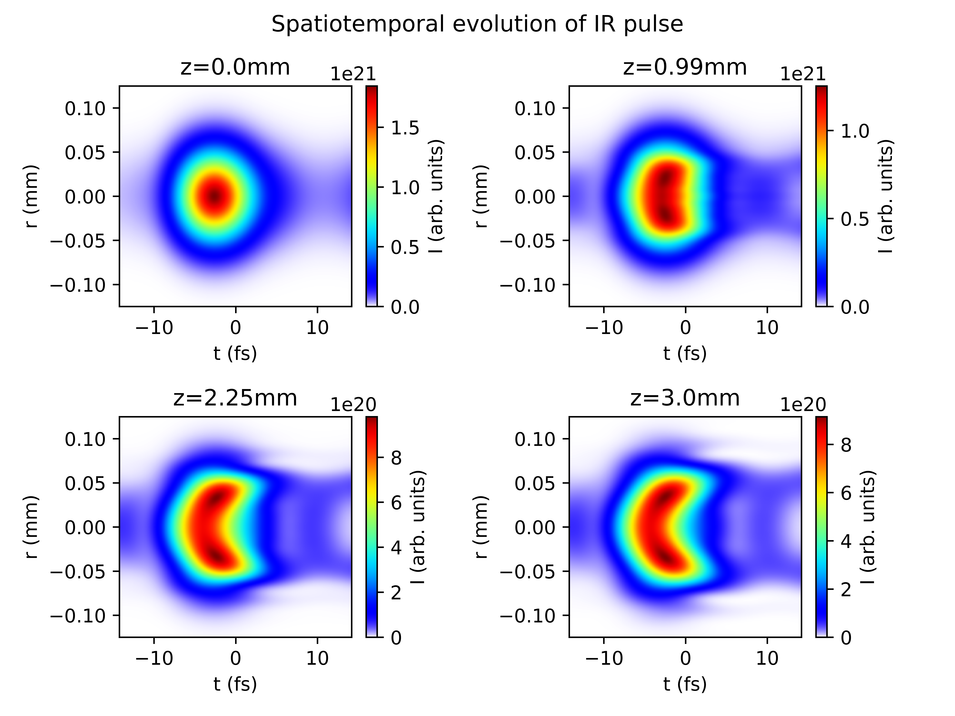
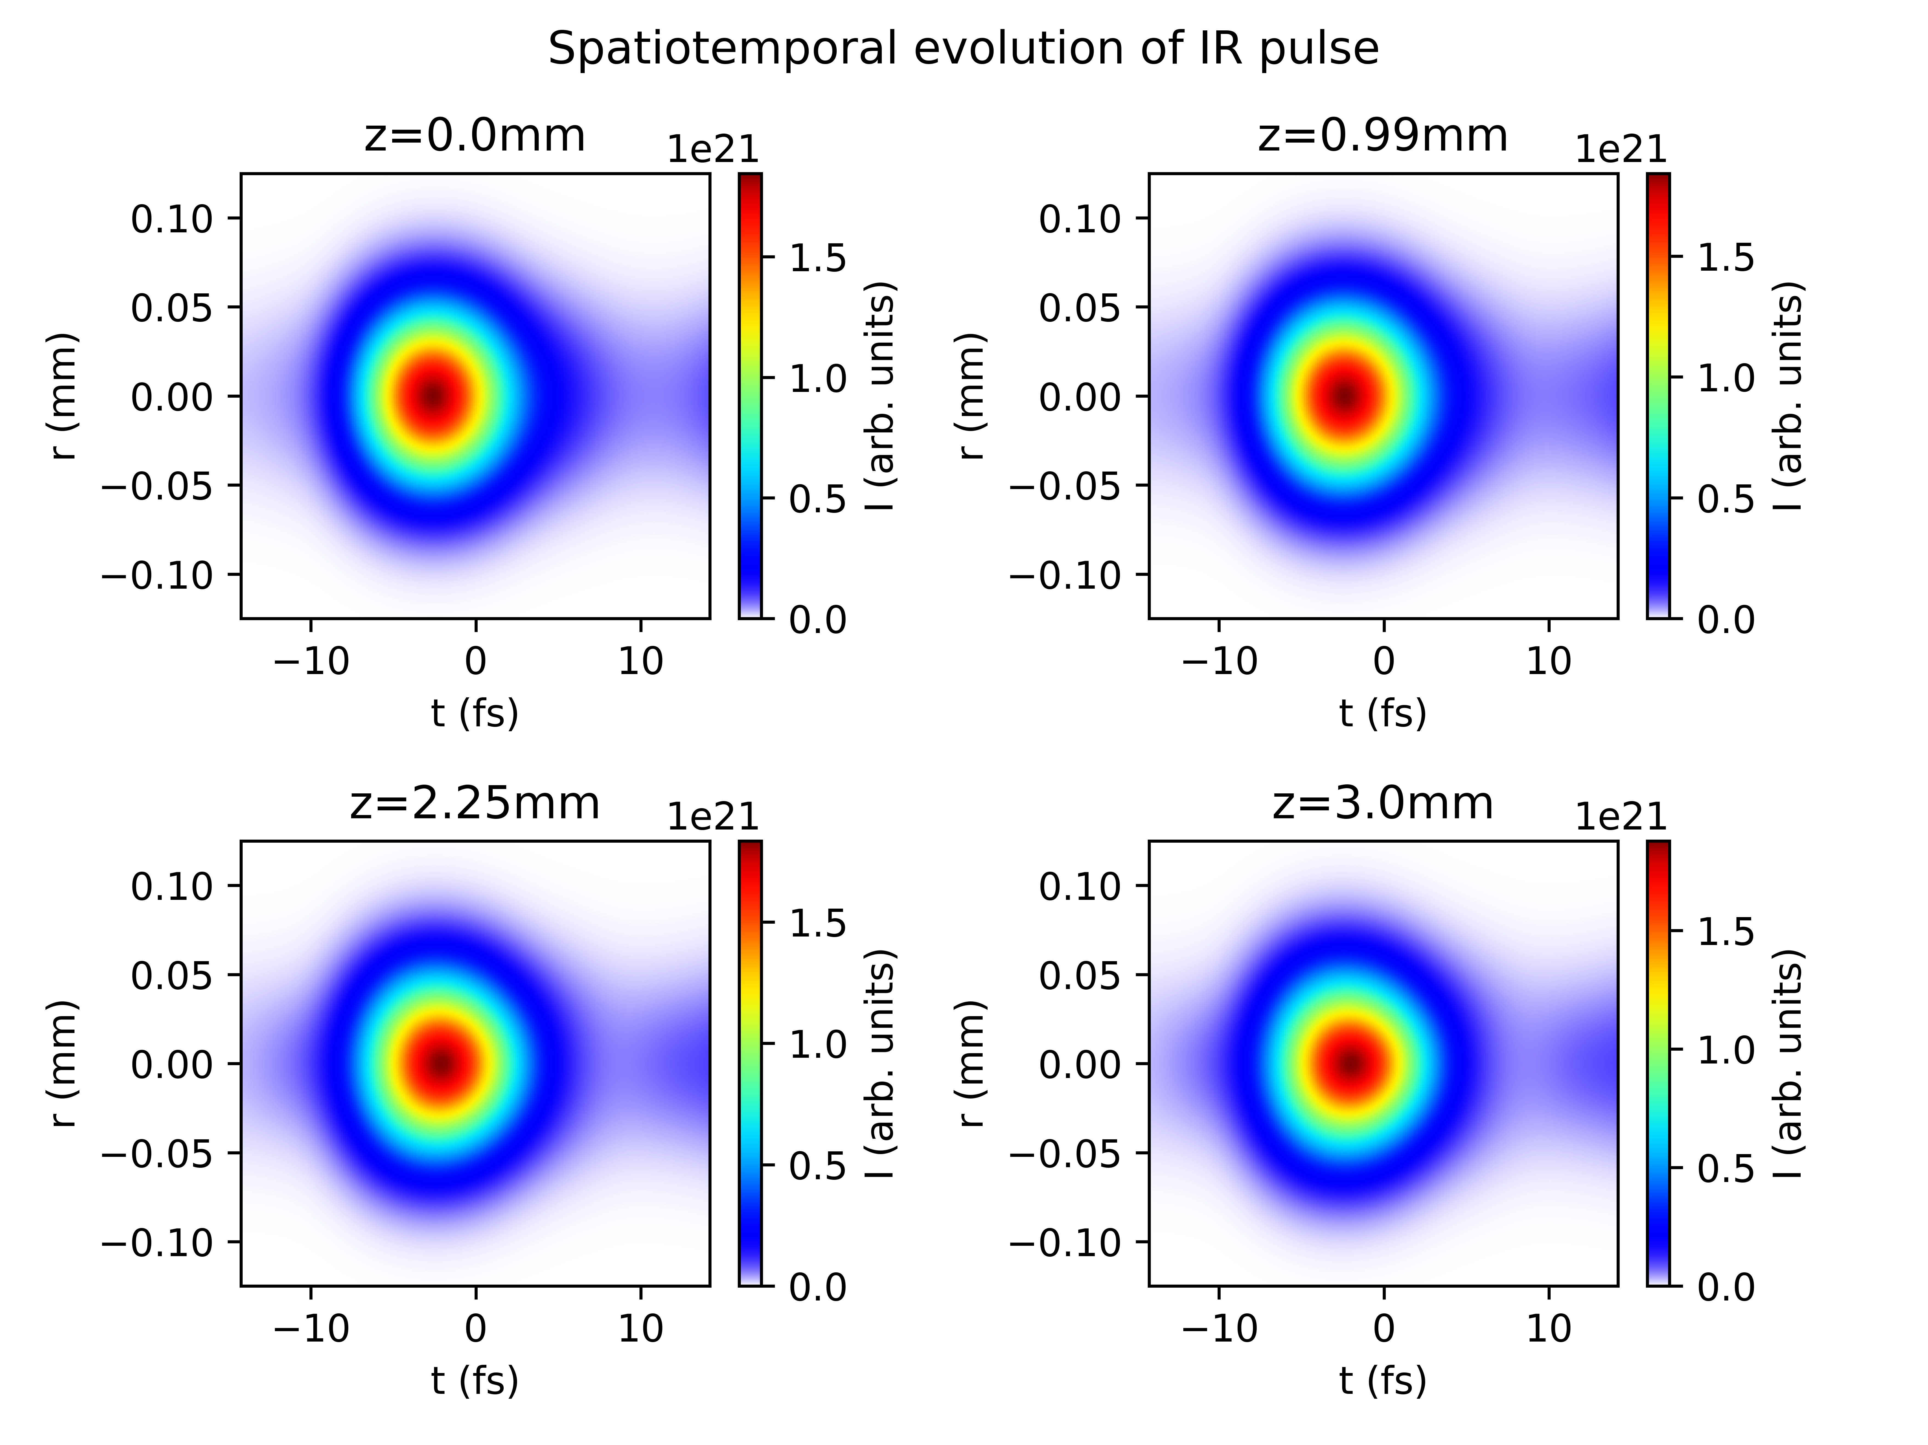
Reproducing plots from Reiter et al. 2010
With ionisation
Without ionisation

Slide 6
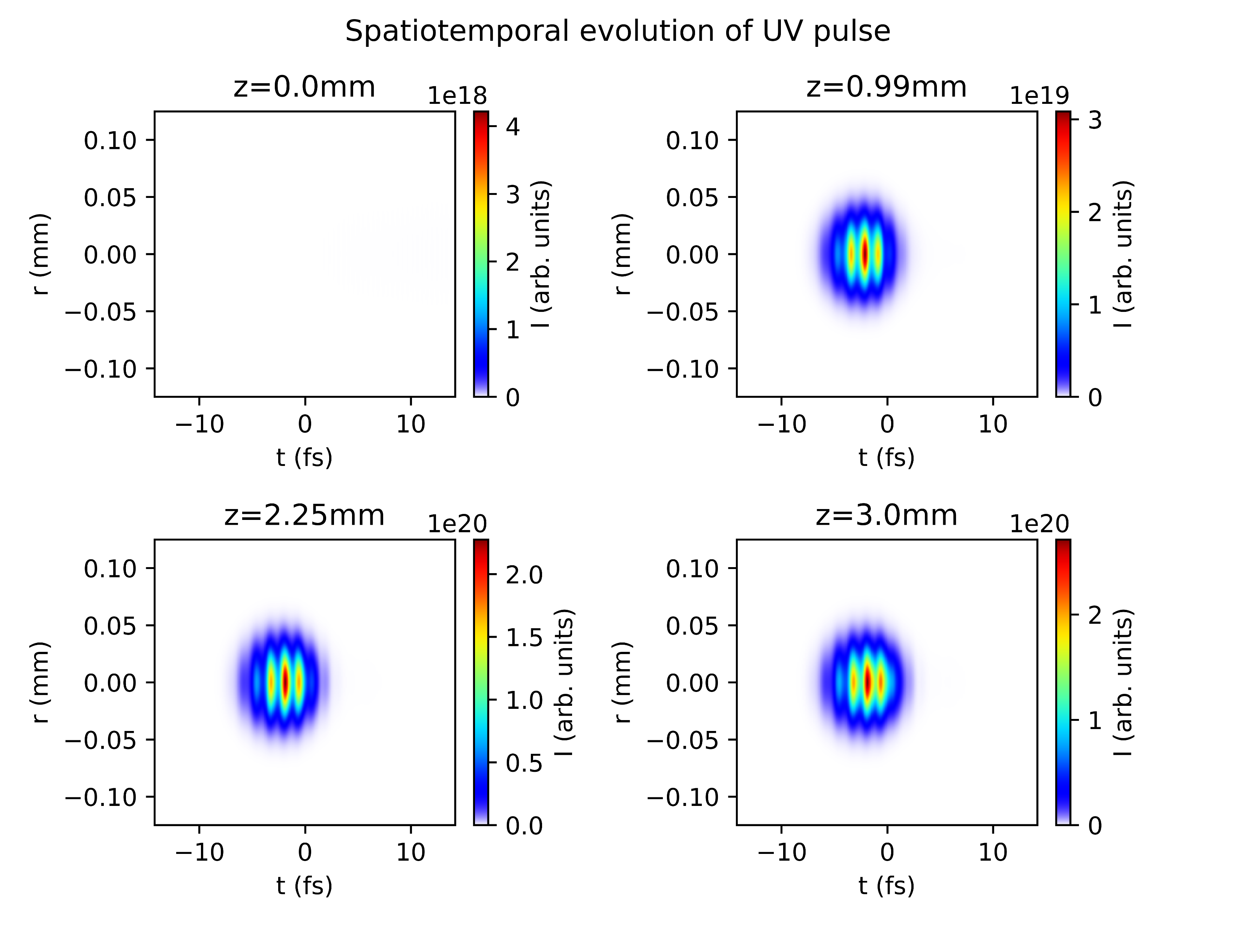
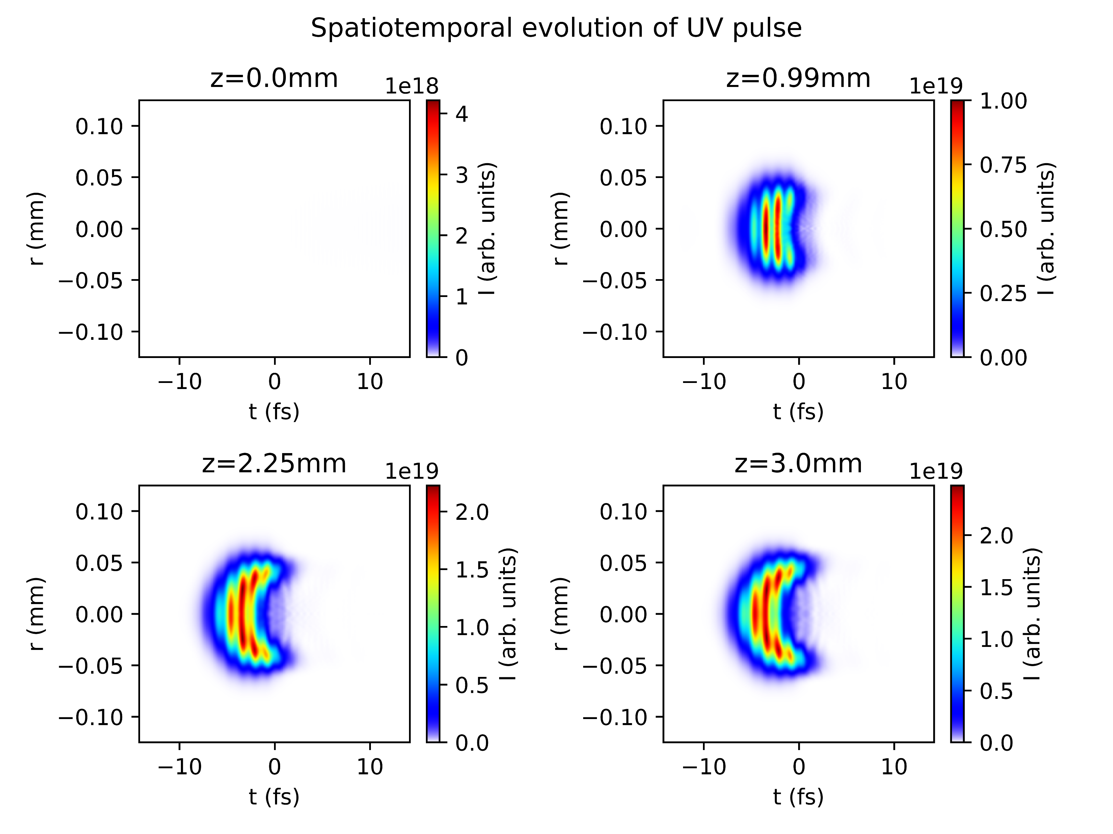
Reproducing plots from Reiter et al. 2010
With ionisation
Without ionisation

Slide 7
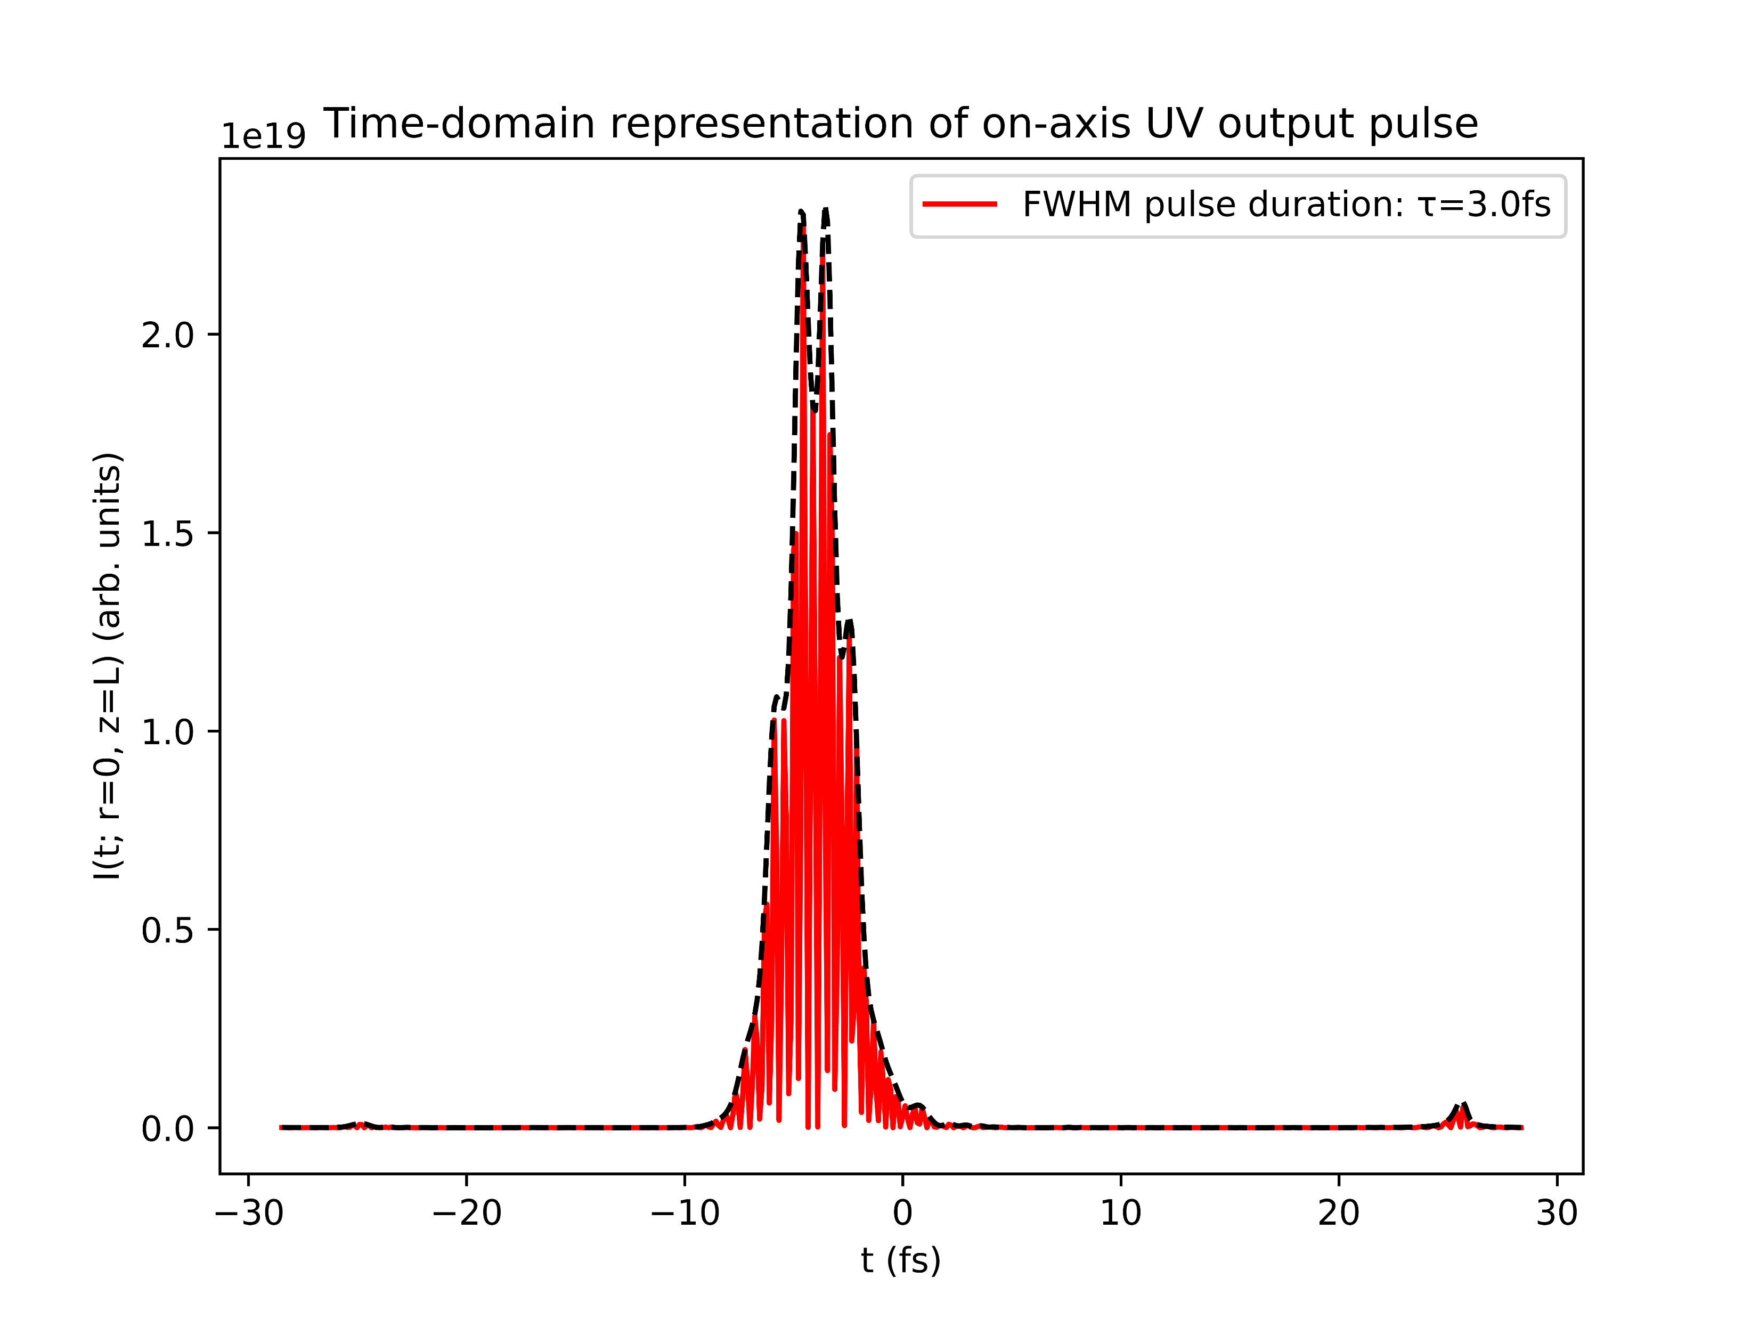
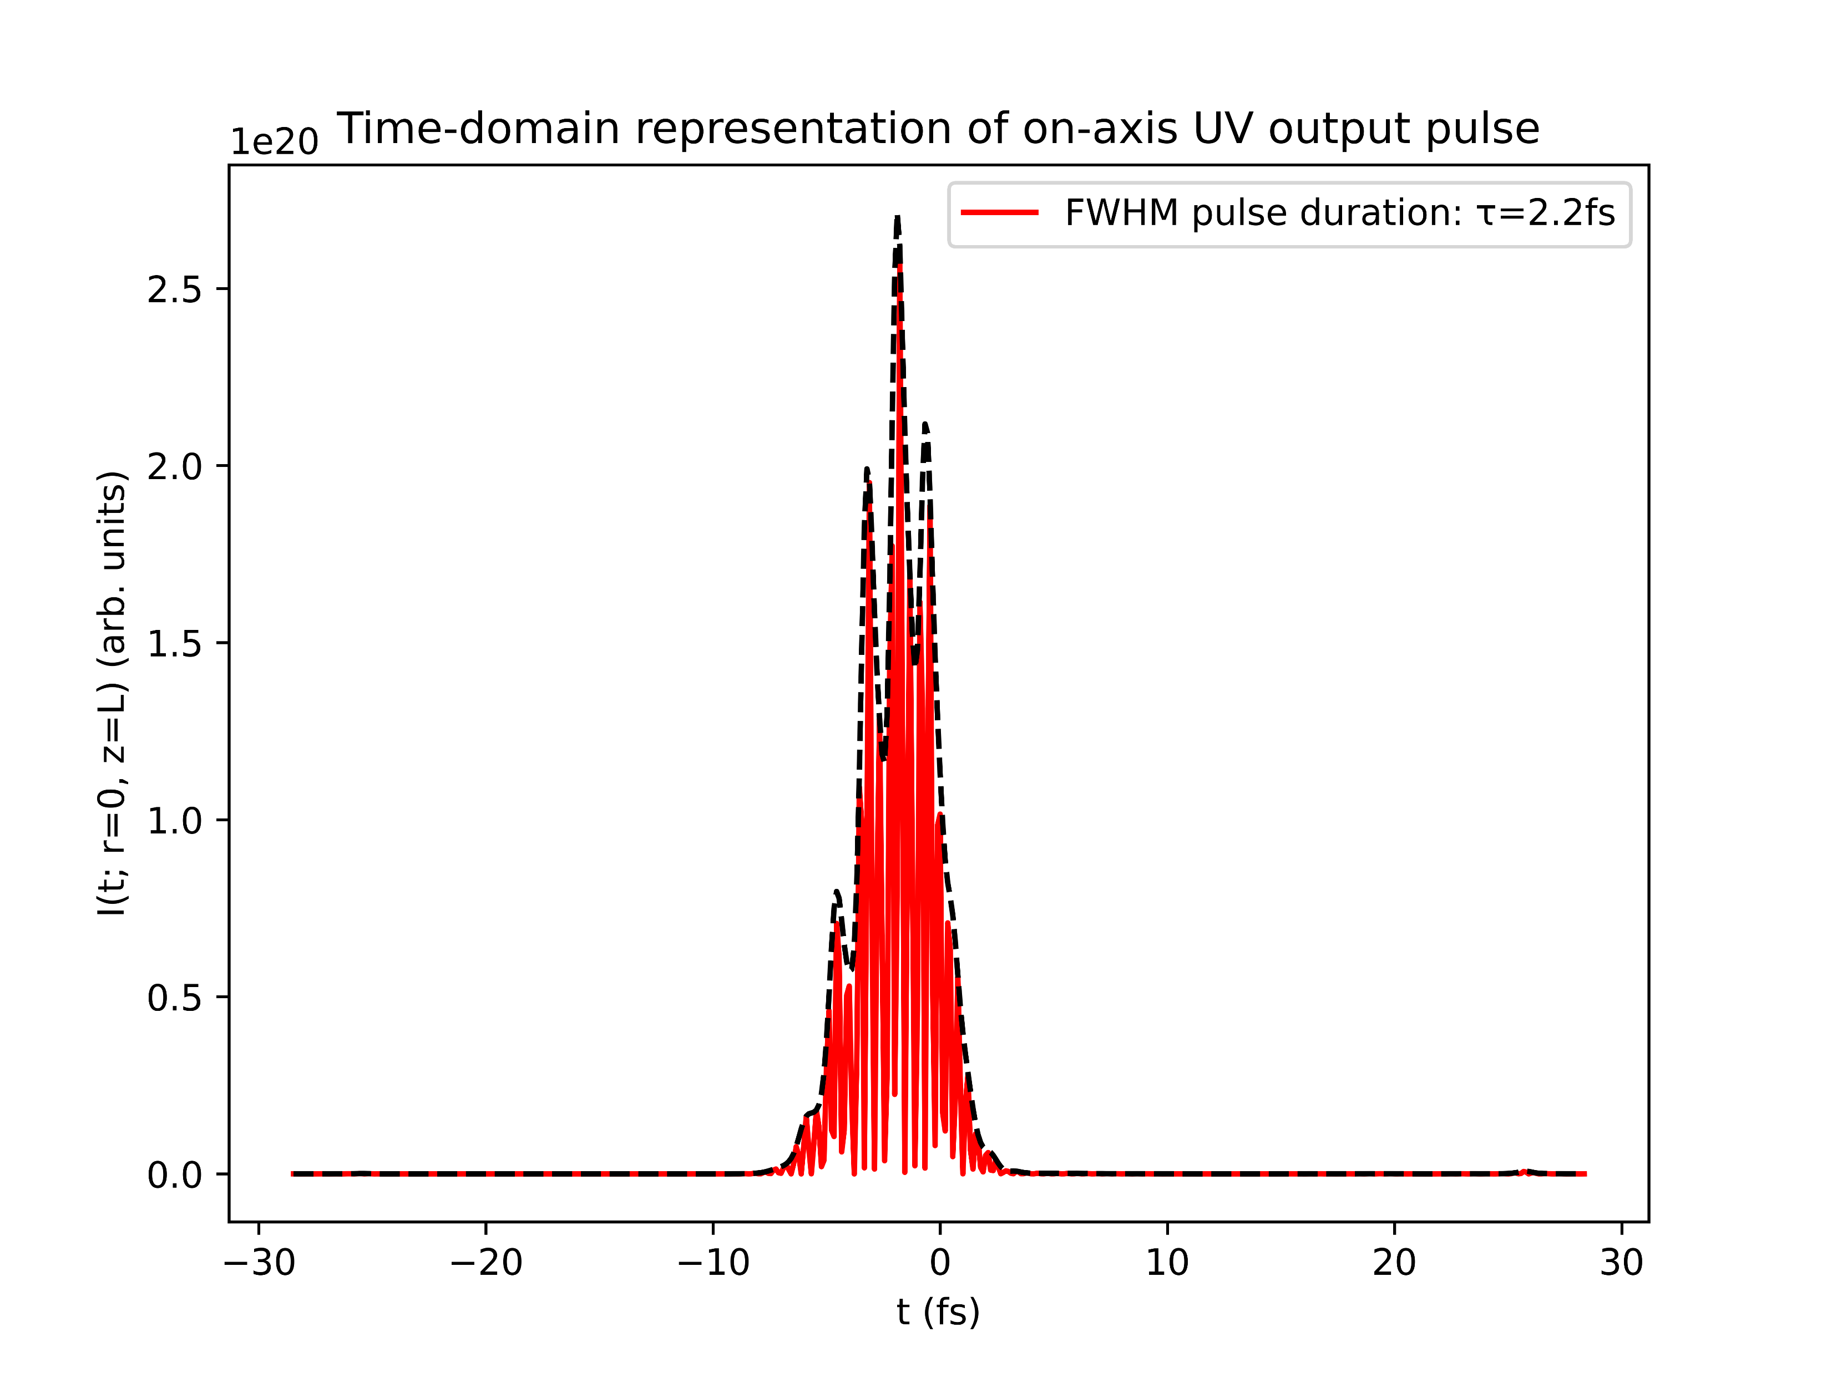
Reproducing plots from Reiter et al. 2010
With ionisation
Without ionisation

Slide 8
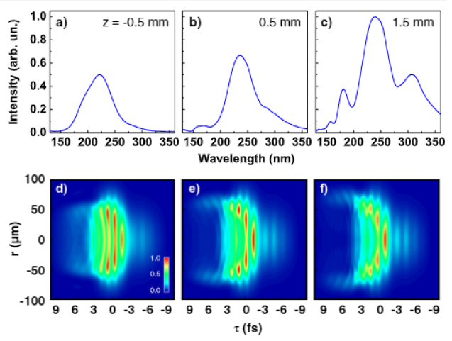
Reproducing plots from Reiter et al. 2010
Simulations show very clear trailing-edge self-steepening
Turning off ionisation mostly suppresses this effect
Unlike in Reiter, however, the UV pulse also shows trailing-edge self-steepening and its duration is decreased by turning off ionisation
Reiter 2010

Slide 9
Testing the COMSOL simulations

Slide 10
List items for discussion with Chris (Luna)
Lacking documentation for Nonlinear.jl response functions
in particular: how do KerrField, PlasmaCumtrapz, etc. relate to specific terms in the UPPE?
Extracting temporal/spectral phase information
Breakdown in PlasmaScalar! (CSpline DomainError in PlasmaCumtrapz)

